Slide 1

CASCADES
Efficiency, productivity, and better results

Slide 2

Problem Statement
A consumer finance company seeks to minimize loan-related risks by analyzing applicant data to predict default likelihood. The objective is to develop a machine learning algorithm that identifies patterns in applicant profiles and loan attributes, using exploratory data analysis (EDA) to determine strong predictors of default. The expected outcome includes a detailed dataset summary, identification of key attributes influencing loan disbursement decisions, and justification for the chosen algorithm to enhance loan approval strategies and mitigate financial losses.

Slide 3
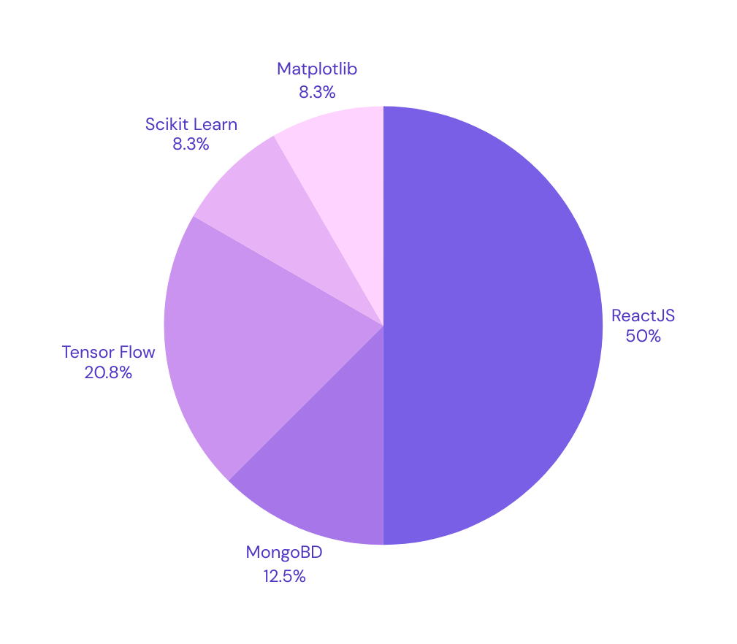
Tech Stack

Slide 4
Features
Loan Default Prediction Model
APPLICANT DEMOGRAPHICS
FINANCIAL ATTRIBUTES
LOAN CHARACTERISTICS
Income
Employment Status (Employed, Unemployed, Self-Employed)
Job Stability (Duration in Current Job)
Monthly Expenses
Age
Gender
Marital Status
Number of Dependents
Loan Amount Requested
Loan Term (Duration)
Interest Rate
Purpose of the Loan

Slide 5
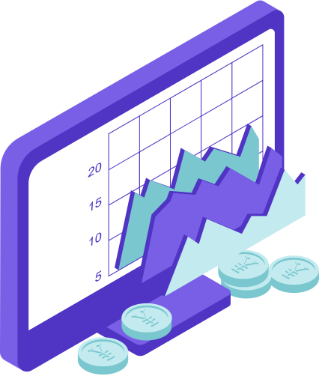
USP
01 | Data-Driven Insights
02 | User-Friendly Interface
03 | Transparency in Scoring
04 | Educational Resources
05 | Real-Time Risk Assessment

